Slide 1
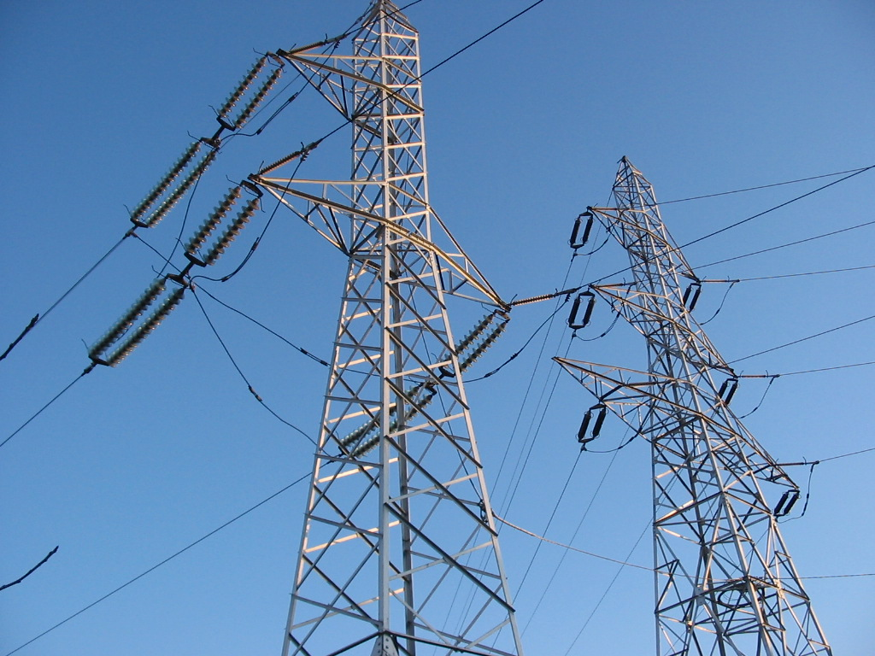
Energy
TEAM DAGGER
George Bigham, Dawn Brenner, Adam Pritchett

Slide 2
Definition
en·er·gy
/ˈenərjē/
power derived from the utilization of physical or chemical resources, especially to provide light and heat or to work machines.

Slide 3
Project hypothesis
A country’s energy consumption and use of “green”
energy increases with its prosperity

Slide 4
OUR QUESTIONS
Is energy consumption increasing or decreasing over time?
Is energy consumption related to a country’s prosperity?
Do more prosperous areas use more “green” energy?
Notes:
Describe the questions you asked, and what motivated us to ask them Describe whether you were able to answer these questions to your satisfaction, and briefly summarize your findings
SWAPPED ORDER OF QUESTIONS

Slide 5
summary
A country’s energy consumption and use of “green”
energy does not always increase with its prosperity
Generation capacity increases with population and prosperity in some cases
Consumption is dependent on other variables (politics, war, etc.)
Consumption per capita is mostly flat globally and in most geographic regions (except decreasing in the US and increasing in Middle East and Asia)
Consumption from “green” fuel sources is not related to prosperity
Notes:
Describe whether you were able to answer these questions to your satisfaction, and briefly summarize your findings
THIS SHOULD INCLUDE NUMERICAL FROM DATA ANALYSIS

Slide 6
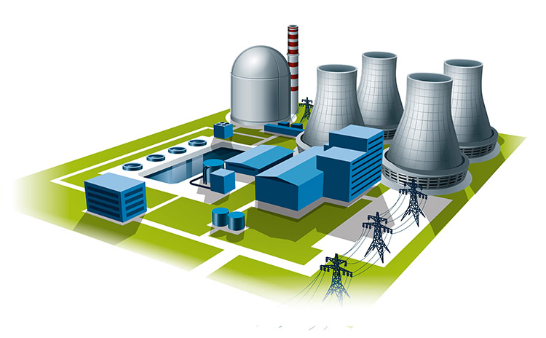



Our Data
CAPACITY
CONSUMPTION
HUMAN DEVELOPMENT INDEX (HDI)
POPULATION
Notes:
Elaborate on the questions you asked, describing what kinds of data you needed to answer them, and where you found it
Describe the exploration and cleanup process
Present and discuss interesting figures developed during exploration, ideally with the help of Jupyter Notebook

Slide 7
Insights / PROBLEMS from data discovery
Political/geographical changes over recent history affect our data
Official country names vs aka names are problematic when merging data from different sources
Data isn’t available for all countries

Slide 8

DATA Analysis

Slide 9
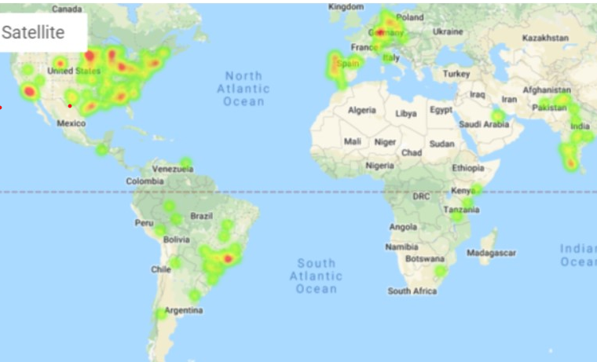
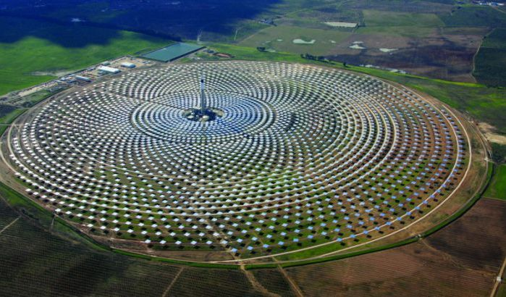
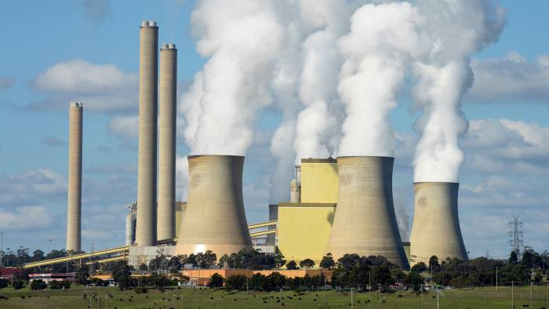
Energy capacity
Maximum energy production capability calculated from power plant commissioning of all fuel types
Source: Global Power Plant Database
Notes:
Discuss the steps you took to analyze the data and answer each question you asked in your proposal Present and discuss interesting figures developed during analysis, ideally with the help of Jupyter Notebook

Slide 10
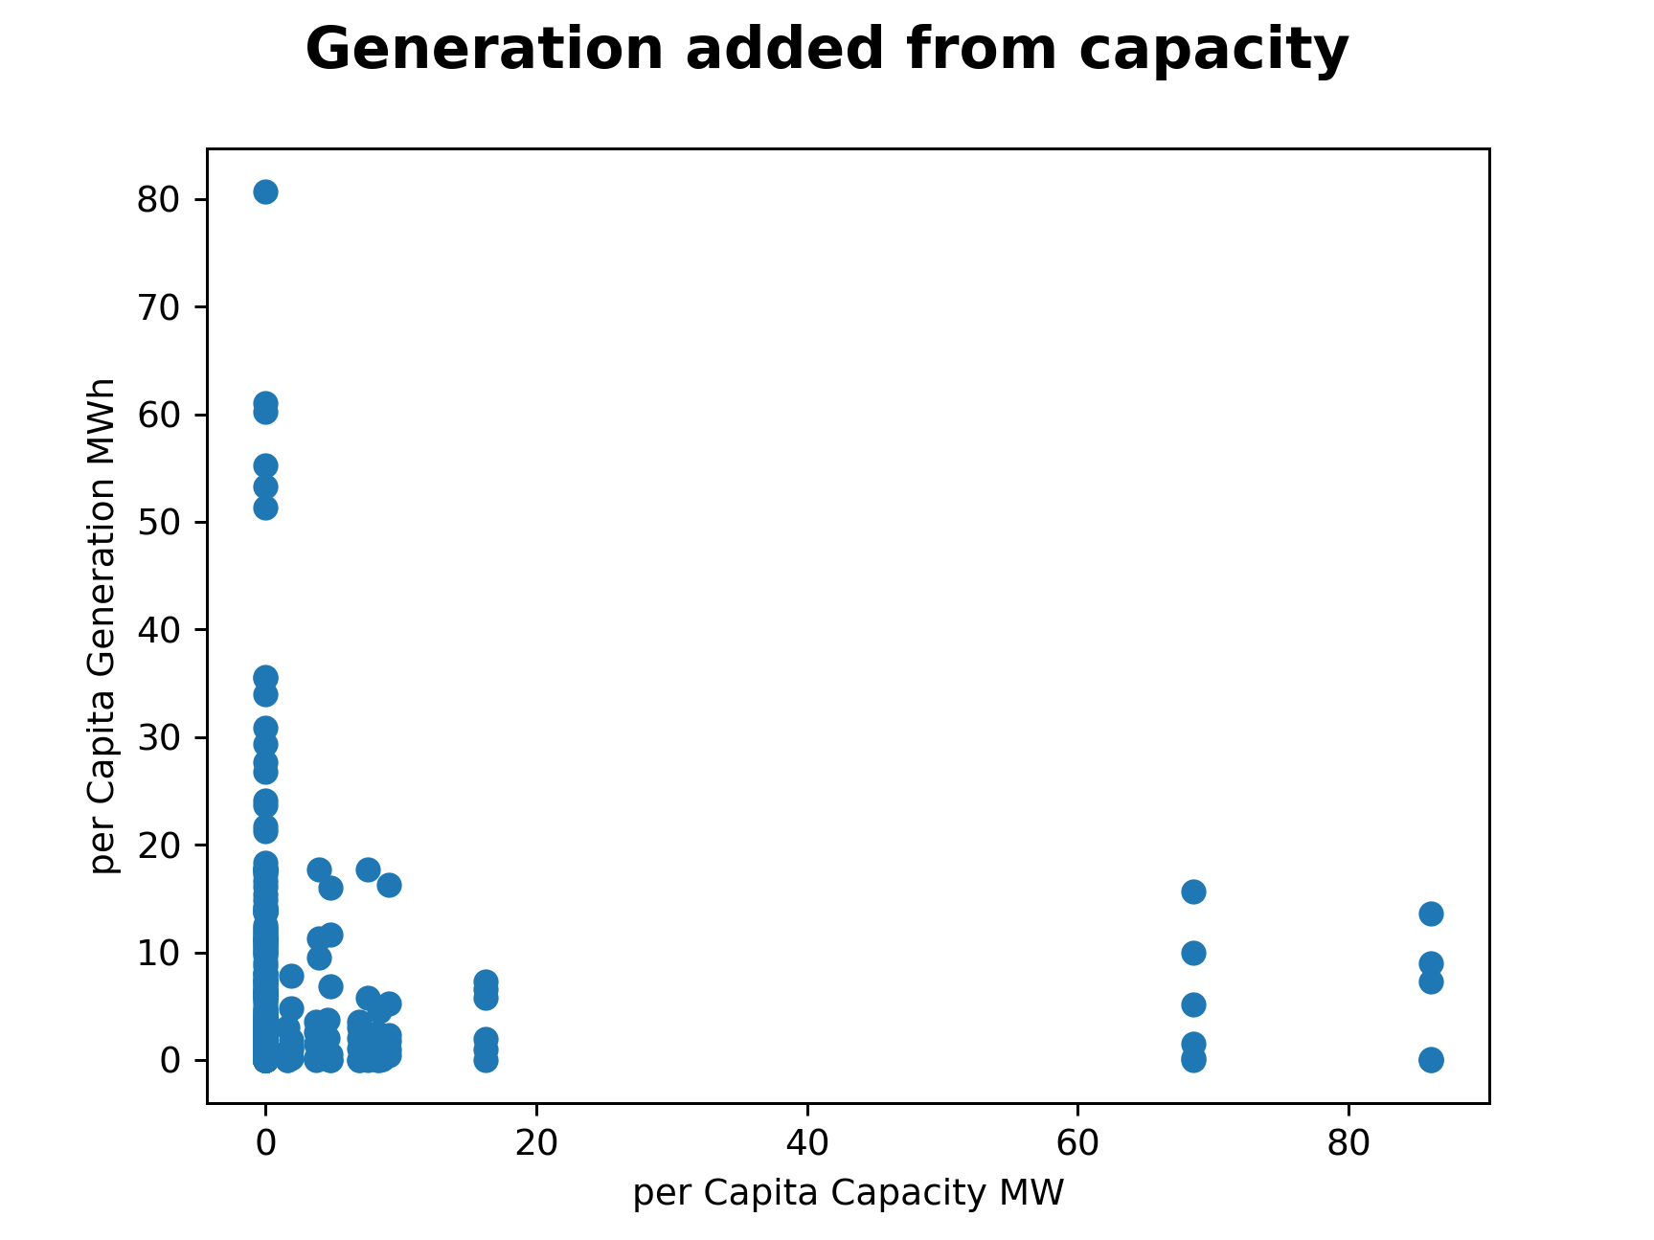
Energy capacity
A linear regression reveals the for every MW added to capacity a countries generation/consumption increases by 0.40 MWh. In other words about 40% of added capacity is used.
Maximum energy production capability calculated from power plant commissioning of all fuel types
Source: Global Power Plant Database
Notes:
Discuss the steps you took to analyze the data and answer each question you asked in your proposal Present and discuss interesting figures developed during analysis, ideally with the help of Jupyter Notebook

Slide 11
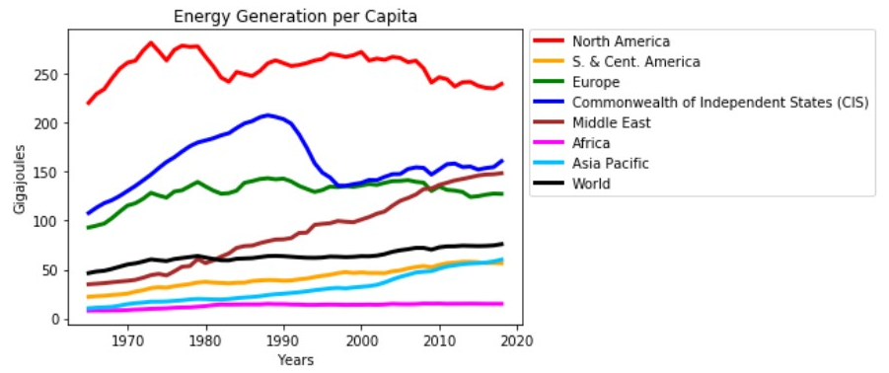
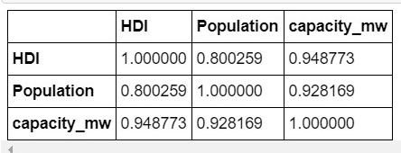
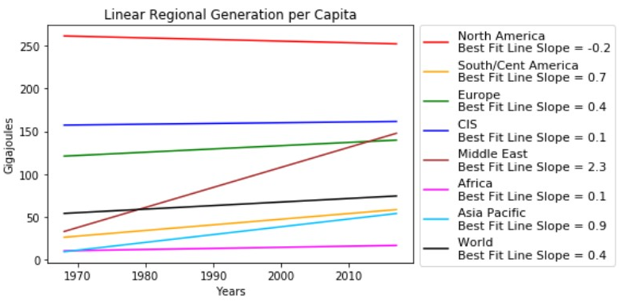
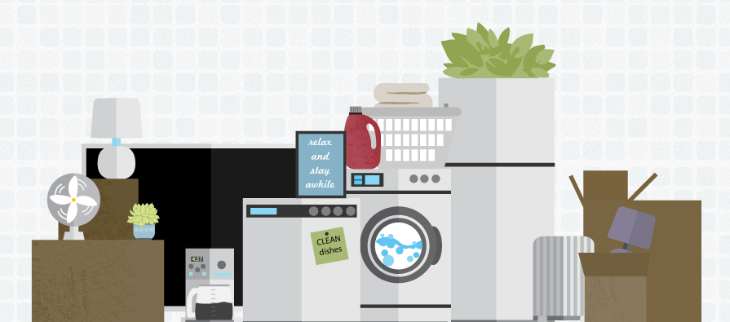
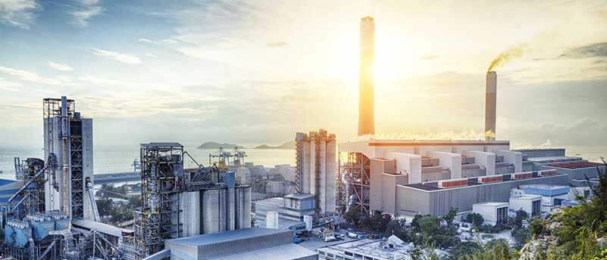
Energy consumption/ Generation
Total amount of energy consumed - residential, commercial, and industrial
Source: BP Statistical Review of World Energy
Notes:
Discuss the steps you took to analyze the data and answer each question you asked in your proposal Present and discuss interesting figures developed during analysis, ideally with the help of Jupyter Notebook
Discuss your findings. Did you find what you expected to find? If not, why not? What inferences or general conclusions can you draw from your analysis?
ADDED Correlation

Slide 12
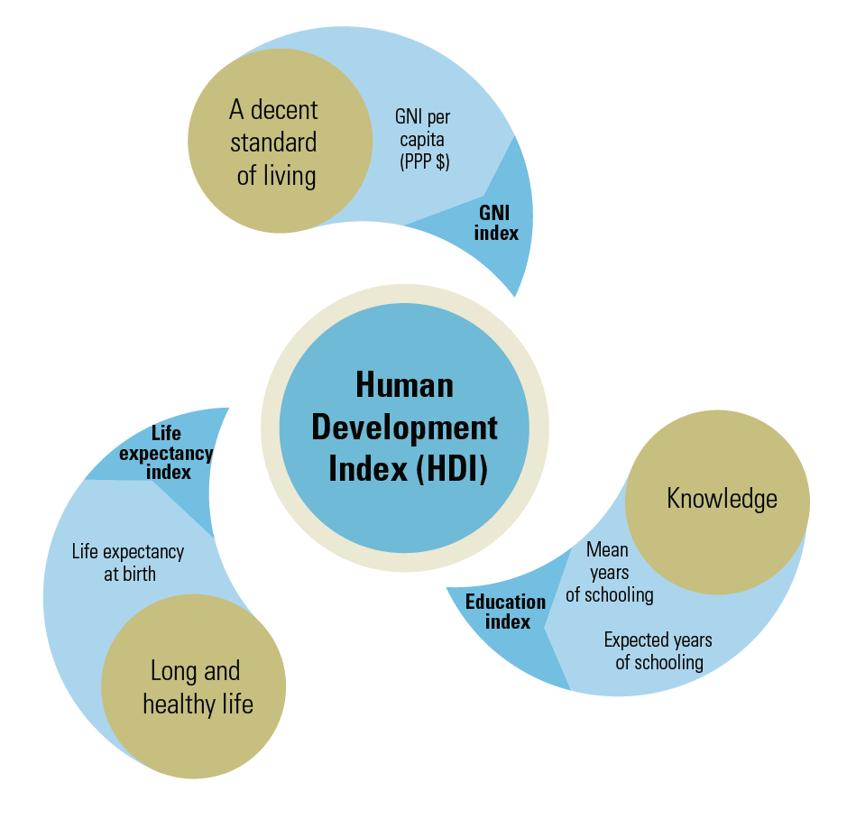
Human development Index (HDI)
Composite statistic of life expectancy, education, and per capita income indicators used to rate a country’s prosperity
Source: United Nations Human Development Data
Notes:
Discuss the steps you took to analyze the data and answer each question you asked in your proposal Present and discuss interesting figures developed during analysis, ideally with the help of Jupyter Notebook
Discuss your findings. Did you find what you expected to find? If not, why not? What inferences or general conclusions can you draw from your analysis

Slide 13
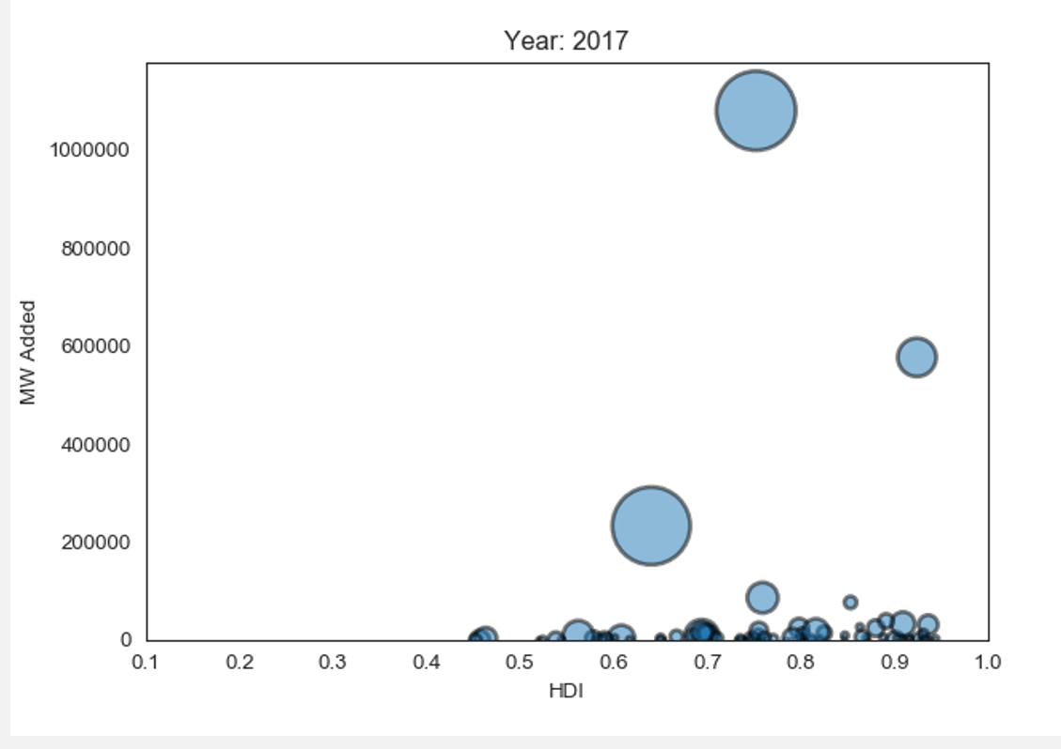
Human development Index (HDI)
Composite statistic of life expectancy, education, and per capita income indicators used to rate a country’s prosperity
Source: United Nations Human Development Data
Notes:
Discuss the steps you took to analyze the data and answer each question you asked in your proposal Present and discuss interesting figures developed during analysis, ideally with the help of Jupyter Notebook
Discuss your findings. Did you find what you expected to find? If not, why not? What inferences or general conclusions can you draw from your analysis

Slide 14
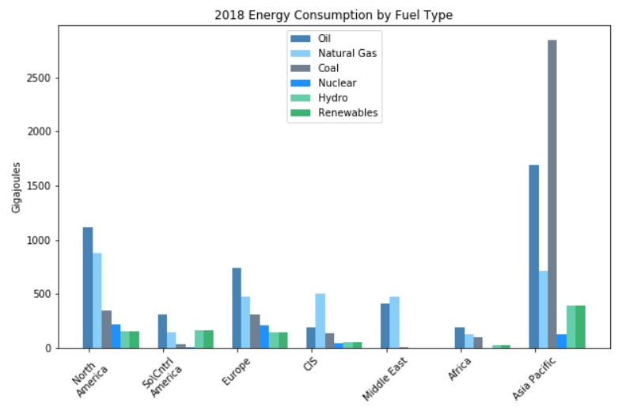
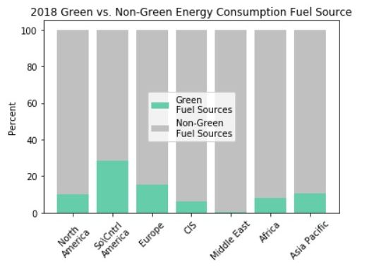
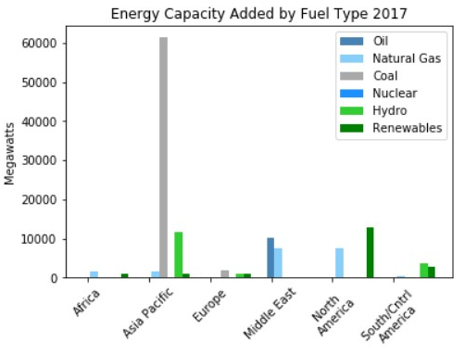
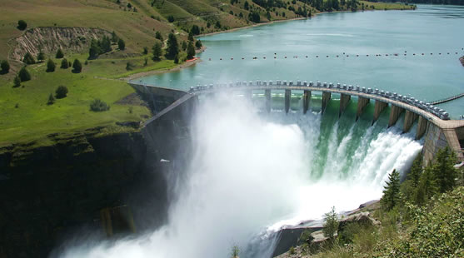
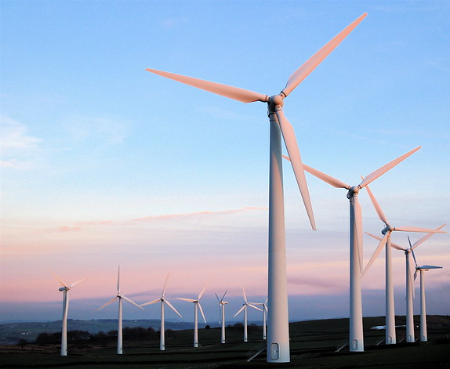
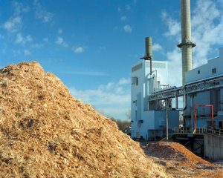
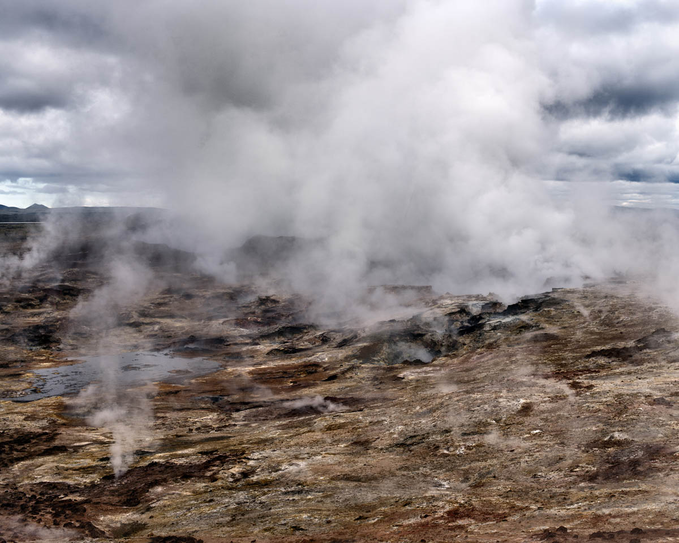
Energy consumption by fuel type
Green Sources = Hydro & Renewables (Solar, Wind, Biomass, Geothermal)
Non-Green Sources = Oil, Natural Gas, Nuclear, & Coal
Source: BP Statistical Review of World Energy
Notes:
Discuss the steps you took to analyze the data and answer each question you asked in your proposal Present and discuss interesting figures developed during analysis, ideally with the help of Jupyter Notebook
Discuss your findings. Did you find what you expected to find? If not, why not? What inferences or general conclusions can you draw from your analysis?
ADDED SOURCES & NUCLEAR to Non-green description

Slide 15
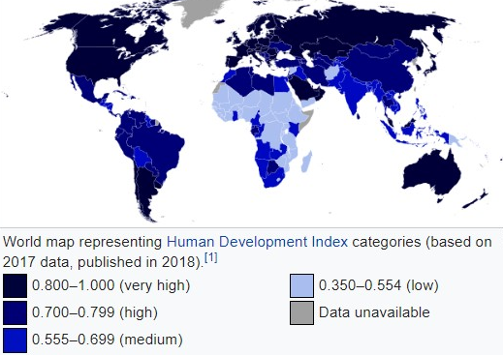

Slide 16
Post Mortem
Find alternative data sources
Search for missing data (Africa)
Baseline capacity before 1990
Learn how to label Google Maps
Research other indicators for areas where HDI didn’t correlate with energy use/capacity
Notes:
Discuss any additional questions that came up, but which you didn't have time to answer:
What would you research next, if you had two more weeks?

Slide 17

Questions

